Slide 1
Please set up your page like this Rule the page and write down a tile and the date.
24.07.2017
Introduction to Landforms and Landscapes

Slide 2
Write down the following…
Learning Intention: Understand the difference between a landform and a landscape.
Activity One: Brainstorm natural features that make up Australia’s Natural Identity. (Minimum of 5 examples of natural features)

Slide 3
Watch the video…
https://www.youtube.com/watch?v=dNOa_XXt8xY
As you watch you can add more examples to your list and note down anything you find interesting

Slide 4
Write down the following definitions…
Landform
Landscape

Slide 5
Watch the video…
https://www.youtube.com/watch?v=BsqKTJtK_vw
As you watch you can add more examples to your list and note down anything you find interesting

Slide 6
Write down the following…
Key inquiry question:
What are different types of landscapes and their distinctive landform features?

Slide 7
Instructions
For each photograph of a landscape:
Name the landscape type
How do you know its that type of landscape? (List the landforms you see)
Provide examples of this landscape found in the world.

Slide 8
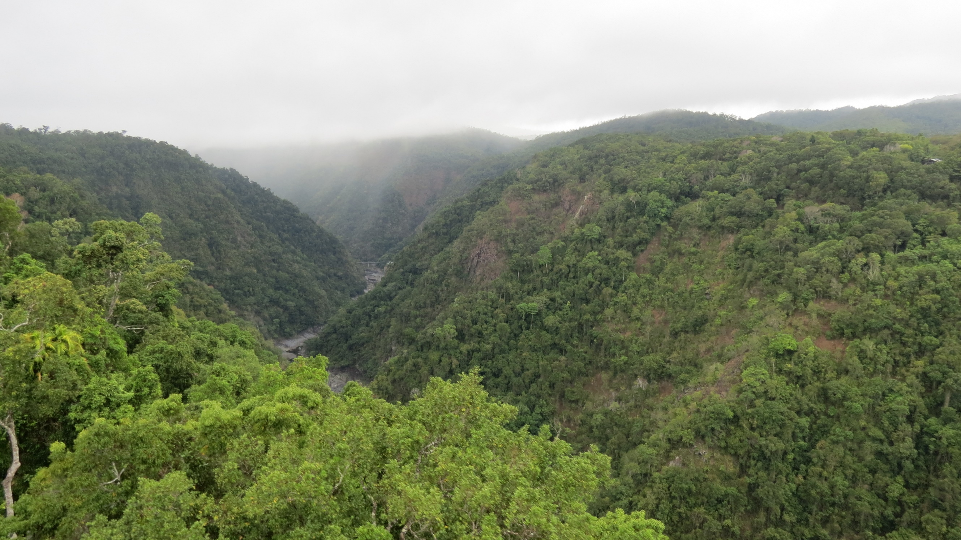

Slide 9
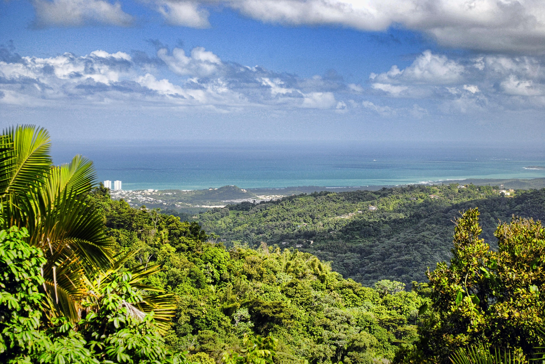

Slide 10
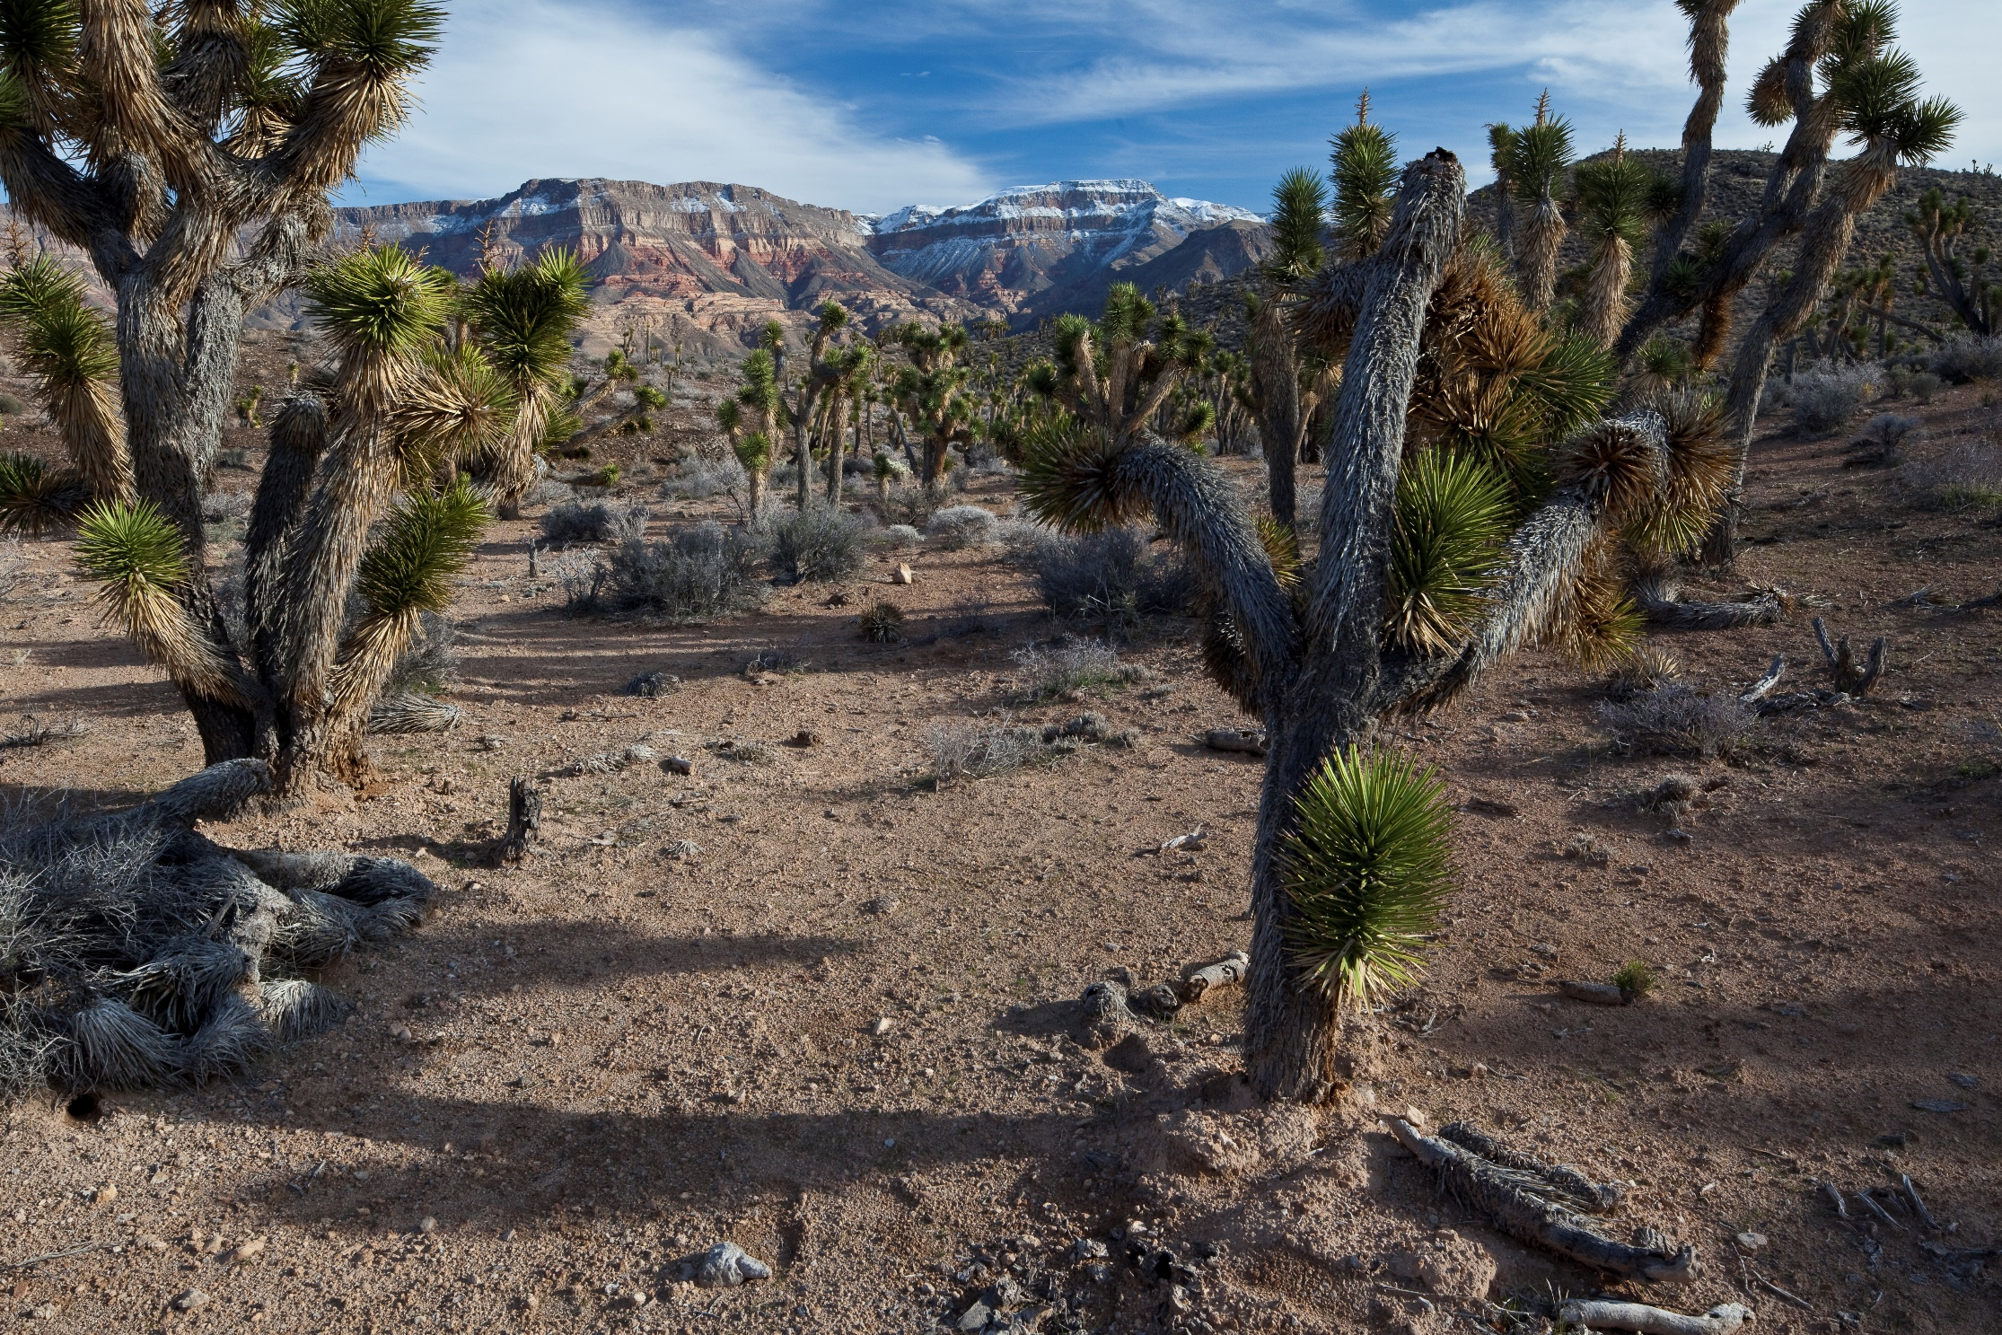

Slide 11
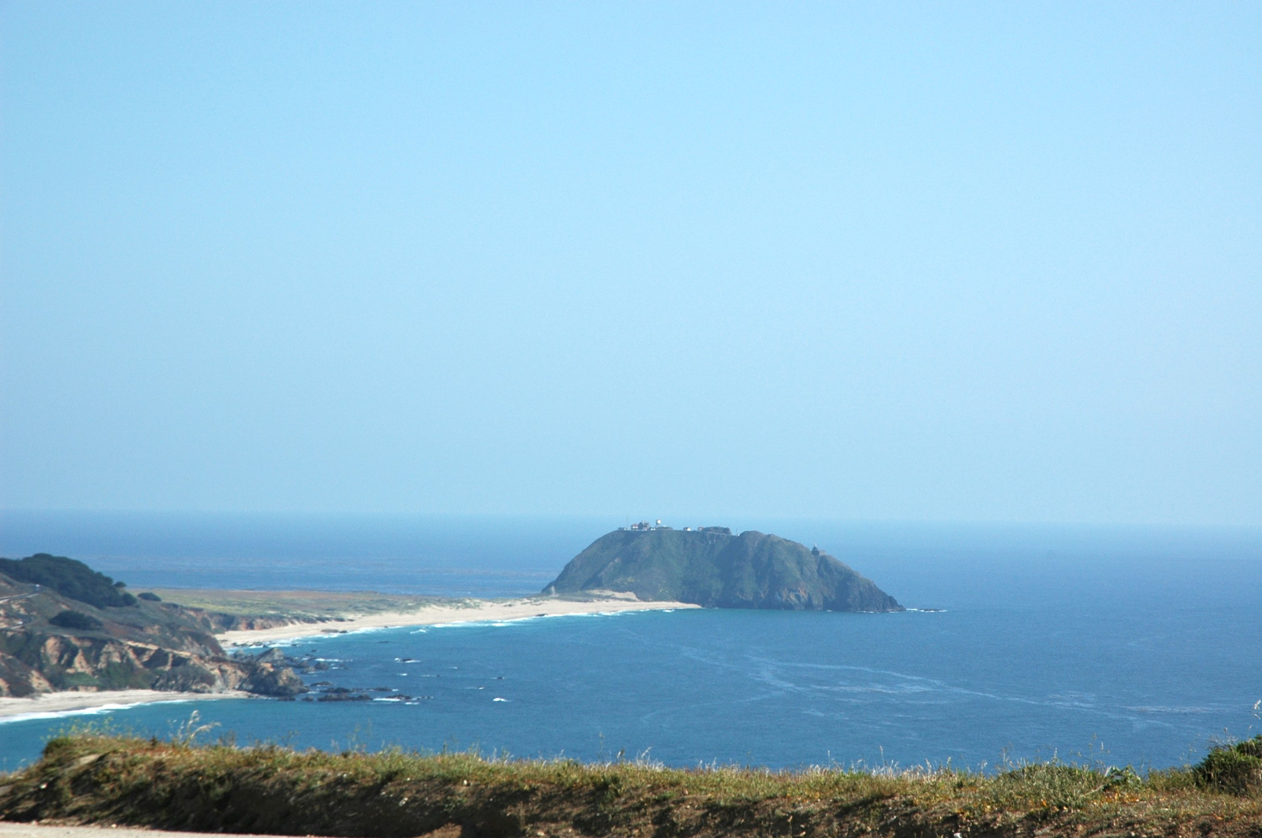

Slide 12
Conclusion
Name an example of a landform and a landscape and explain the difference between the two.
End the less with the video: https://www.youtube.com/watch?v=jadND9e1YyE World’s interesting landforms

